Slide 1
Advanced Development Pipelines
Adam Anderson,
MCSA,

Slide 2
Explore PASS

Slide 4
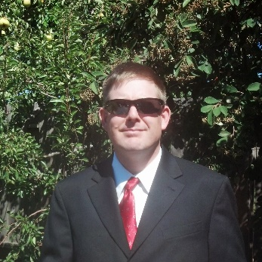
Adam Anderson
IT since 1995
Databases 2006
MCSA 2018
Senior BI Developer
/adam-Anderson-dba
@sqlpioneer

Slide 5
Agenda
DevOps Pipelines Introduction
YAML Pipeline
Build Dacpac
YAML Pipeline Deploy to container
Deploy Dacpac to sidecar container
Environment Automation
Summary

Slide 6

DevOps Pipelines

Slide 7
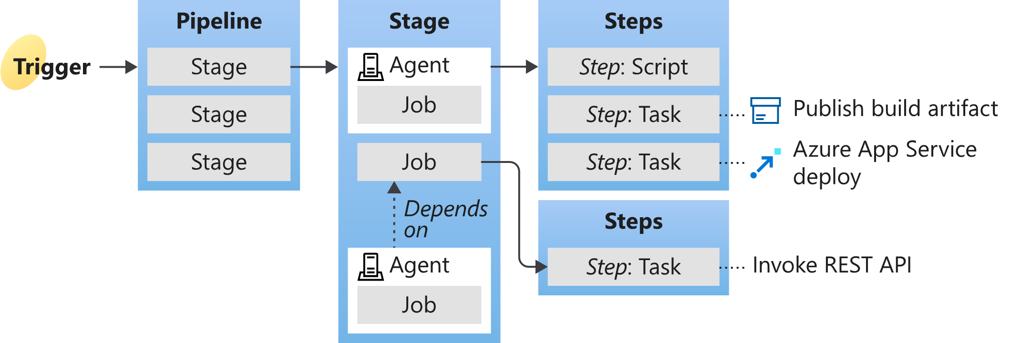
Azure Pipelines Key Concepts
https://docs.microsoft.com/en-us/azure/devops/pipelines/get-started/key-pipelines-concepts?view=azure-devops

Slide 8
Pipeline
Resources
Pipelines
Containers
Code Repositories
Variables
Trigger
Name
Value
Group
Push
Pull
Schedule
Pipeline
Stages
Pool
DependsOn
Condition
Variables
Jobs[ job | template ]

Slide 9
Job
DependsOn
Condition
Strategy
Pool
Container
Variables
Steps
Services

Slide 10

Table
Variables
User-defined
Predefined
String
Number
Boolean
YAML Object
System
Build
Pipeline
Deployment
Group
Agent
Library
Passwords
Reusable
Key Vault
https://docs.microsoft.com/en-us/azure/devops/pipelines/process/variables?view=azure-devops&tabs=yaml%2Cbatch

Slide 11
Table
Variable Syntax
Syntax | Example | When
Macro | $(var) | Runtime before task
Template expression | ${{ variables.var }} | Compile time
Runtime expression | $[ variables.var ] | Runtime
https://docs.microsoft.com/en-us/azure/devops/pipelines/process/variables?view=azure-devops&tabs=yaml%2Cbatch

Slide 12
BASIC YAML Pipeline
trigger:
- master
pool:
vmImage: 'windows-latest’
steps:
- task: Powershell@2
inputs:
script: Get-ChildItem

Slide 13
Optional Hierarchy
# Optional
Stages:
- stage: name
jobs:
- job: JobName
# Required
Steps:
- task: Powershell@2
inputs:
script: Get-ChildItem

Slide 14
Alternative Formatting
- task: Powershell@2
inputs:
script: Get-ChildItem
- powershell: gci $Env:variable
- pwsh: $Env:Agent_Name
- task: Powershell@2
inputs:
targetType: filepath
filepath: $(Variable.Path)
arguments: -name Adam
Notes:
On Windows the Pwsh task uses pwsh.exe (PowerShell Core) instead of Powershell.exe

Slide 15
References
YAML schema reference
https://docs.microsoft.com/en-us/azure/devops/pipelines/yaml-schema?view=azure-devops&tabs=schema%2Cparameter-schema
Variable Groups
https://docs.microsoft.com/en-us/azure/devops/pipelines/library/variable-groups?view=azure-devops&tabs=yaml
Predefined Variables
https://docs.microsoft.com/en-us/azure/devops/pipelines/build/variables?view=azure-devops&tabs=yaml
Job Definition
https://docs.microsoft.com/en-us/azure/devops/pipelines/process/phases?view=azure-devops&tabs=yaml

Slide 16

Build Pipeline
https://github.com/SQLPioneer/AdvancedADOPipelines/tree/master/1Basic

Slide 17
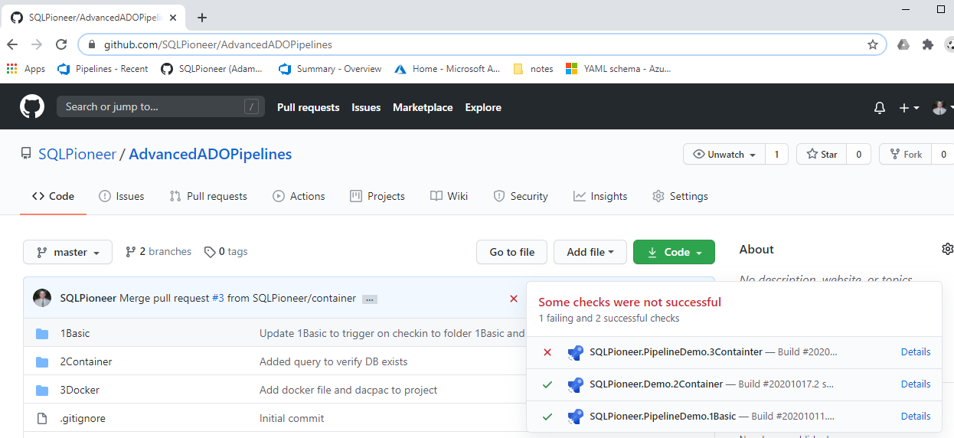
Github/SQLPioneer

Slide 18
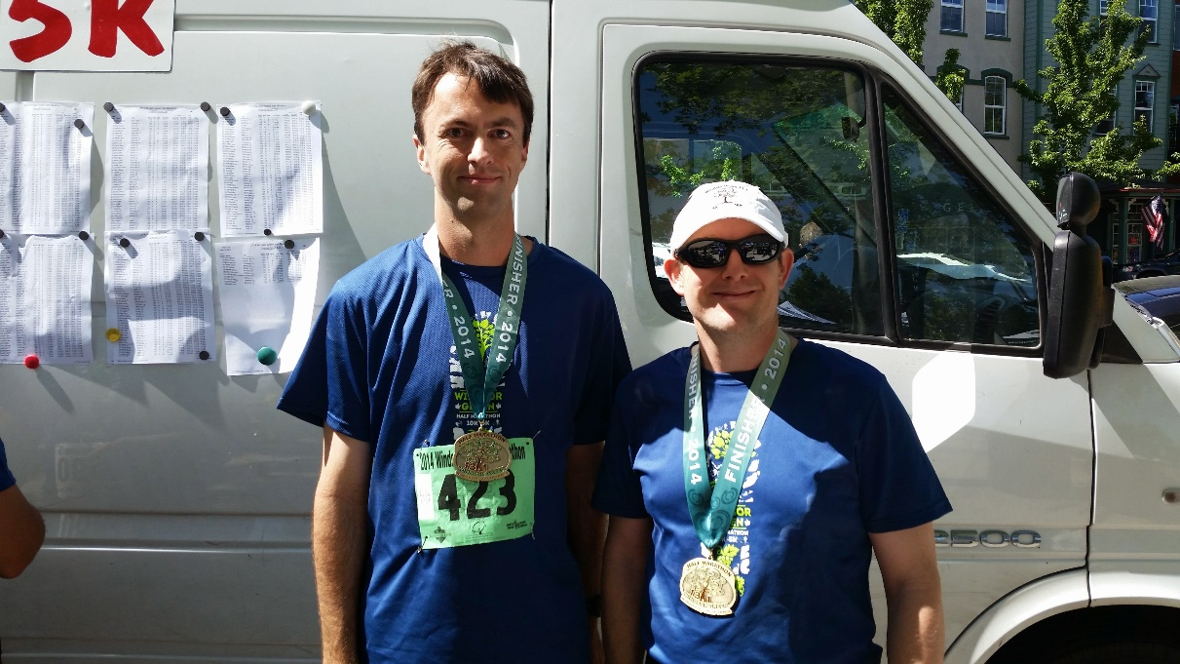
Container and Services

Slide 19
VM and Container Must Match OS
Virtual Machine
Ubuntu-Latest
Windows Container
Windows-Latest
Linux Container

Slide 20
Container Architecture
vmImage
vmImage
Service: mssql
Port 1433:1433
Service: MSSQL
Container: MyBuild

Slide 21
VM and Container Must Match OS
Strategy
Matrix
SQL2017
Service
Container: 2017
Sql2019
Service
Container: 2019

Slide 22
Container Resource Definition
resources:
containers:
- container: mssql2017
image: mcr.microsoft.com/mssql/server:2017-latest
ports:
- 1433:1433
env:
ACCEPT_EULA: Y
SA_PASSWORD: $(saPassword)
MSSQL_PID: Express
options: --name mssql2017

Slide 23
Container as a Service
strategy:
matrix:
SQLServer2017:
mssqlService: mssql2017
SQLServer2019:
mssqlService: mssql2019
continueOnError: true
pool:
vmImage: 'ubuntu-latest'
services:
mssql: $[ variables['mssqlService'] ]

Slide 24
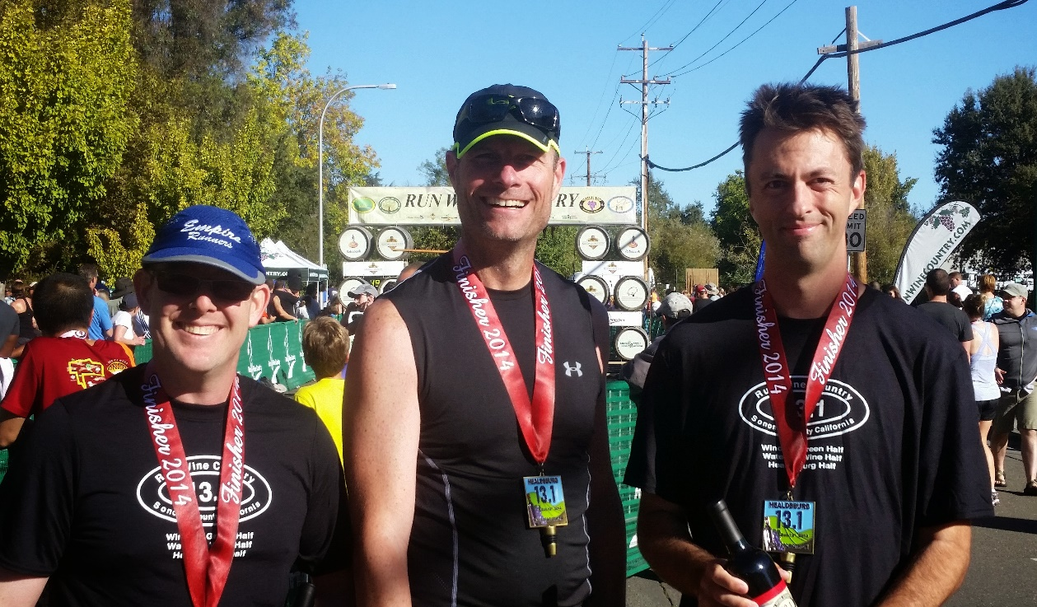
Environment Automation

Slide 25
Environment Automation
Azure SQLDB
App Services
Kubernetes
Virtual Machine (On Prem and in the cloud)

Slide 26
Deployment Strategy
RunOnce
Rolling
Canary
All Deploys Same Time
Parallel Deployment x or %
VMs Only
Parallel by increments
Health Check Possible
Kubernetes Only
Deployment Quantities can Increase each Round
https://docs.microsoft.com/en-us/azure/devops/pipelines/process/environments?view=azure-devops

Slide 27
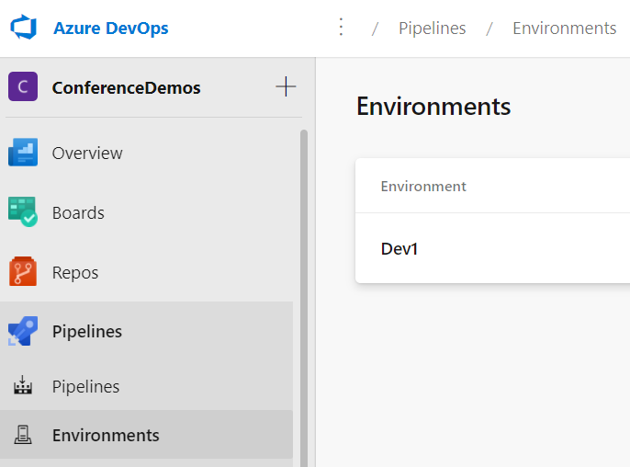
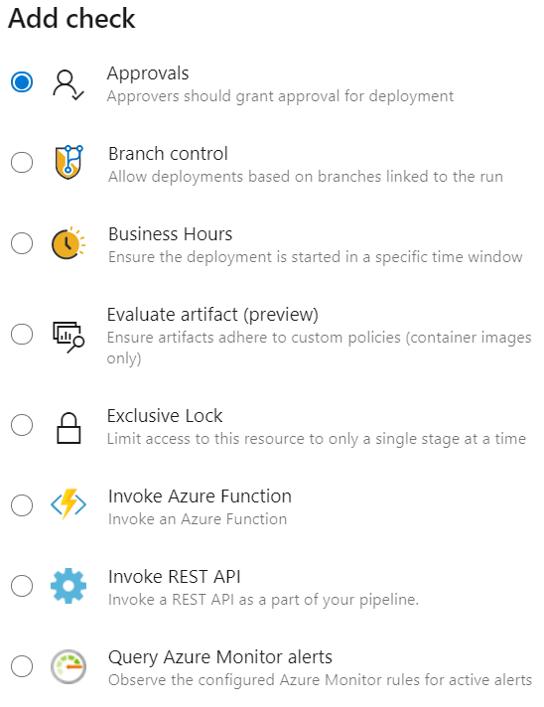
Environment Setup

Slide 28
Environment Setup
- stage: DeployToDev1
dependsOn: BuildStage
jobs:
- deployment: DeploytoDev1
displayName: 'Deploy to Dev1'
environment:
name: Dev1
resourceType: VirtualMachine
strategy:
runOnce:
deploy:
steps:
- task: DownloadBuildArtifacts@0
inputs:
buildType: 'current'
downloadType: 'specific'
itemPattern: '**/SchoolProject.dacpac'
downloadPath: '$(System.ArtifactsDirectory)'

Slide 29

Adam Anderson
@sqlpioneer
/adam-Anderson-dba

